Slide 1
Land cover map
Jan 31, 2018

Slide 2
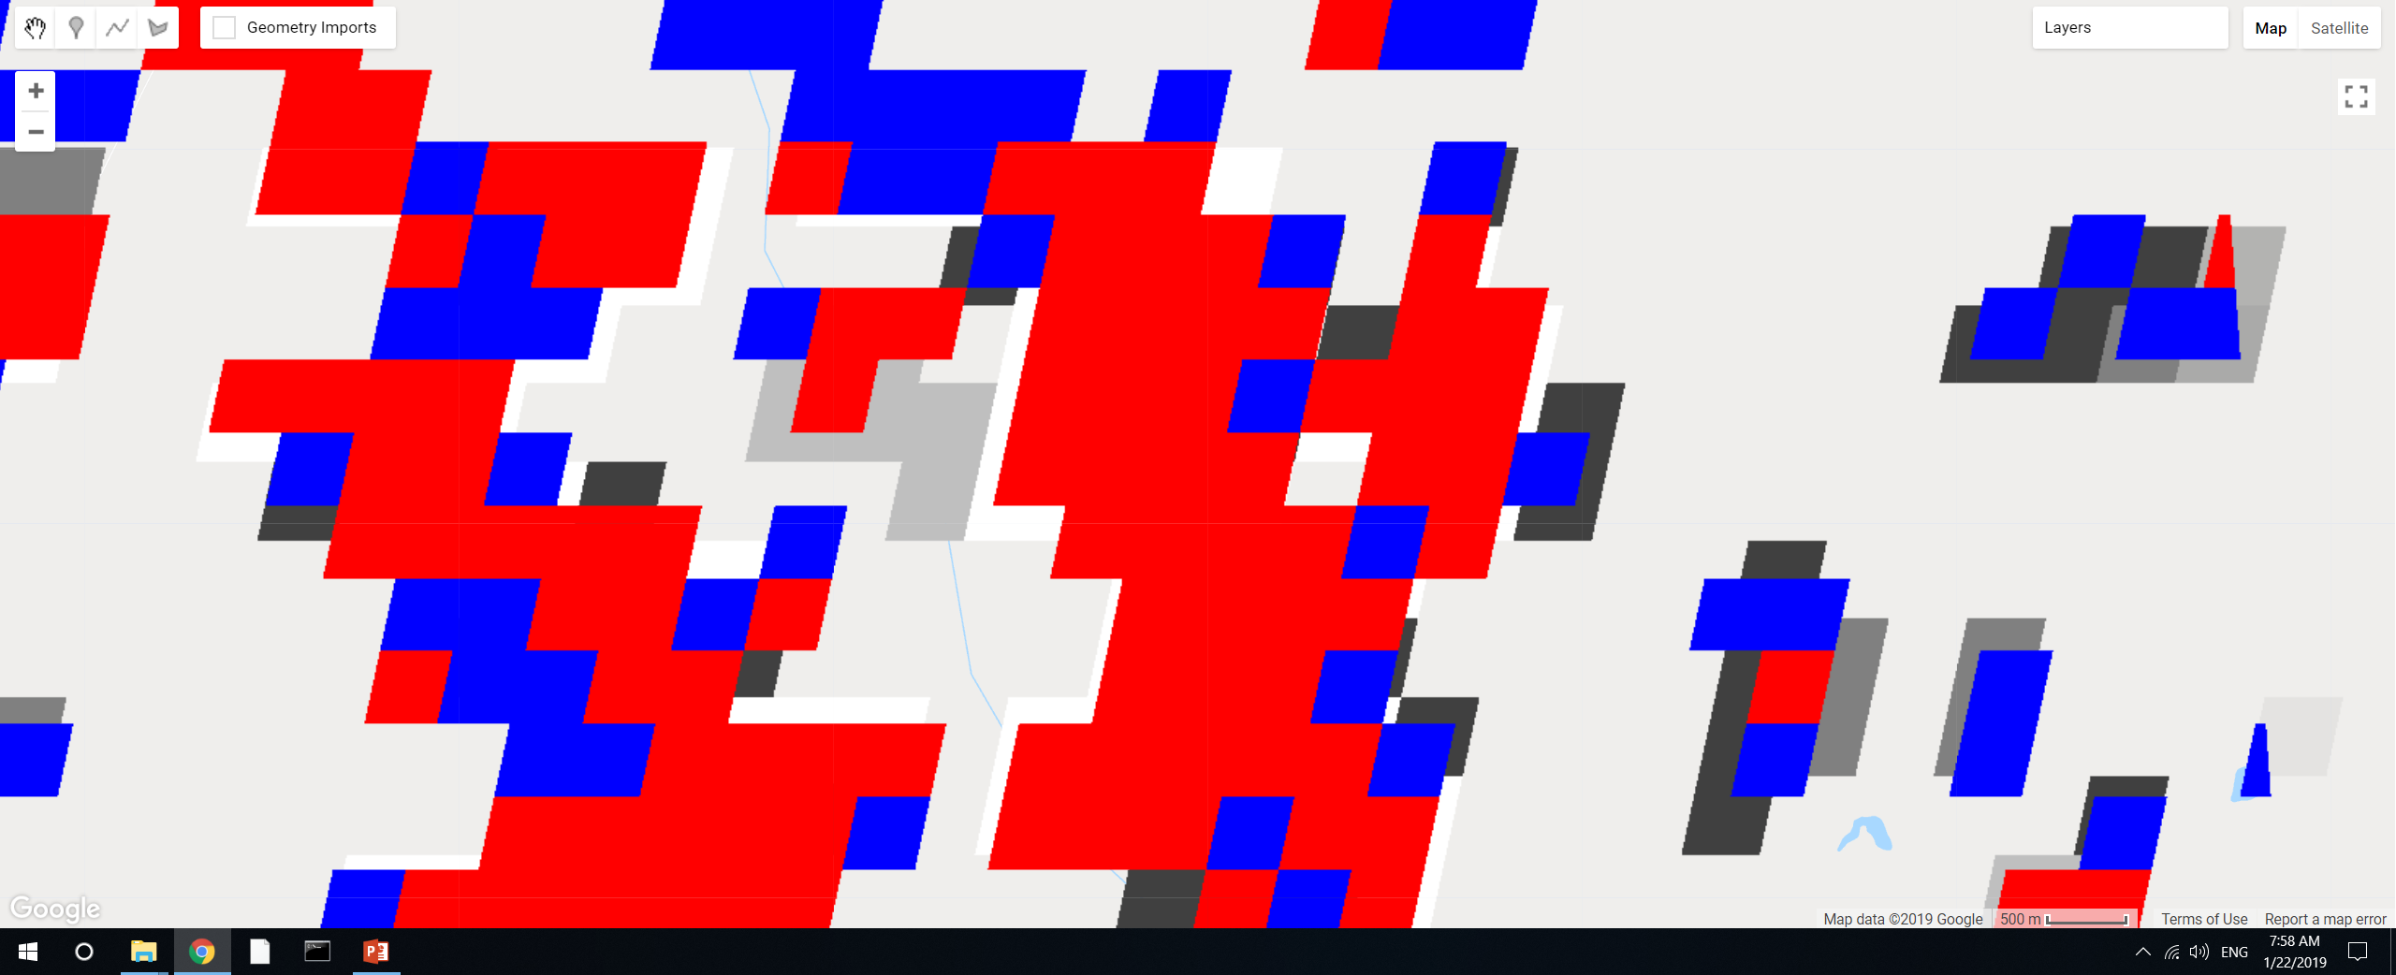
GEE file: LandCover/Soy Classification Masking
Added a small section of code to explore specifics of connectedPixelCount. Red is DC, blue is SC, underlying layer is the ‘count’ from connectedPixelCount, the areas that are not covered by red or blue are class 2 (other agri).
Use 4-connected only. The ‘connection’ is not only for adjacent pixels. So if a ‘red’ pixel is sticking out by itself but it’s connected to a large chunk of ‘red’ pixels, its connected pixels will still be high.
The values of the pixels should be integers. If they’re integers, don’t need to separately mask out DC vs SC; the connected pixels will automatically count only SC or only DC.
If pixels look like they’re only partially masked, it’s probably because they’re masked with a different map. The result of exporting an image should produce whole pixels, though the exact location of the pixels might be mismatched.

Slide 3
Searching for commercial high resolution satellite imagery
Requested quote from Satellite Imaging Corp (QuickBird)
Search for images on LandInfo. Available images to search are:
GeoEye-1
WorldView-1, to -4
QuickBird
IKONOS
SPOT 1- 7
RapidEye
PlaneteScope/Dove
Planet Labs satellites: which ones?

